Slide 1
Influence of Psychological Factors on Bench Press Performance using EMG, IMUs, and VBT Technology
D. Katsoridas, M. Li, K. Pascal, R. Plata and M. Souza

Slide 2
Problem Statement
This study explores how psychological factors impact athletes' bench press
Assessing the performance of five participants under varying psychological conditions
These positive psychological factors include music, verbal encouragement and the presence of a spotter

Slide 3
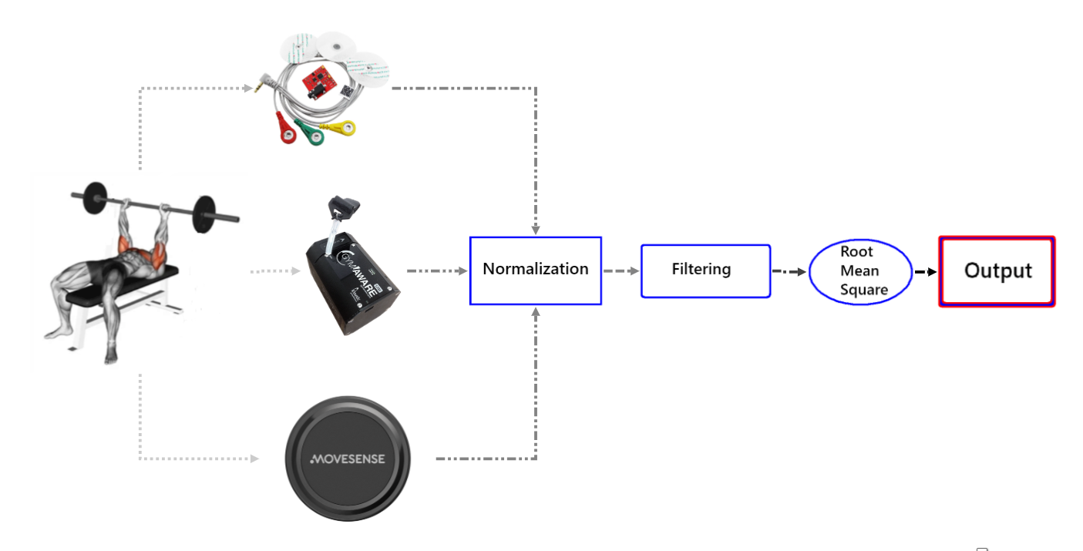
Technical Approach
EMG use:
Six EMGs sensors
IMU use:
Vertical acceleration.
VBT Technology use:
Barbell Velocity

Slide 4
Data Analysis
Data Collection:
8 repetitions were recorded
First and last 2 were excluded
Data Analysis:
Normalization Filtration Root Mean Square Analysis Visualization

Slide 5
Experiment Design
The 5 athletes all followed specific regime during the bench press.
Warm up with the 20kg barbell for 10 reps
First set of 8 repetitions at 70% 1RM
10 minutes break
Second set of 8 repetitions at 70% 1RM with music, auditory encouragement and social cues by the spotters

Slide 6
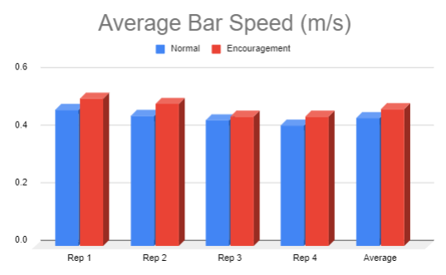
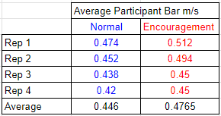
Results (VBT)
-The average bar speed in encouragement sets
exceeds the speed of the normal sets.
- The average participant has an increase of 6,84%
in barbell speed during bench press.

Slide 7
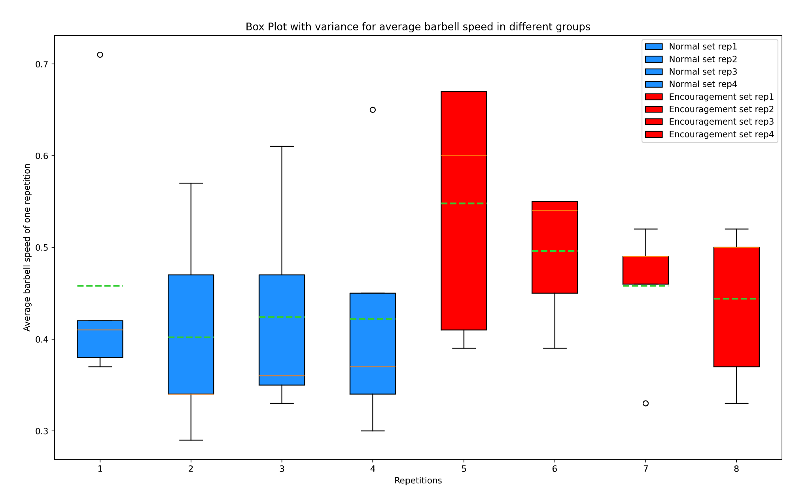
VBT

Slide 8
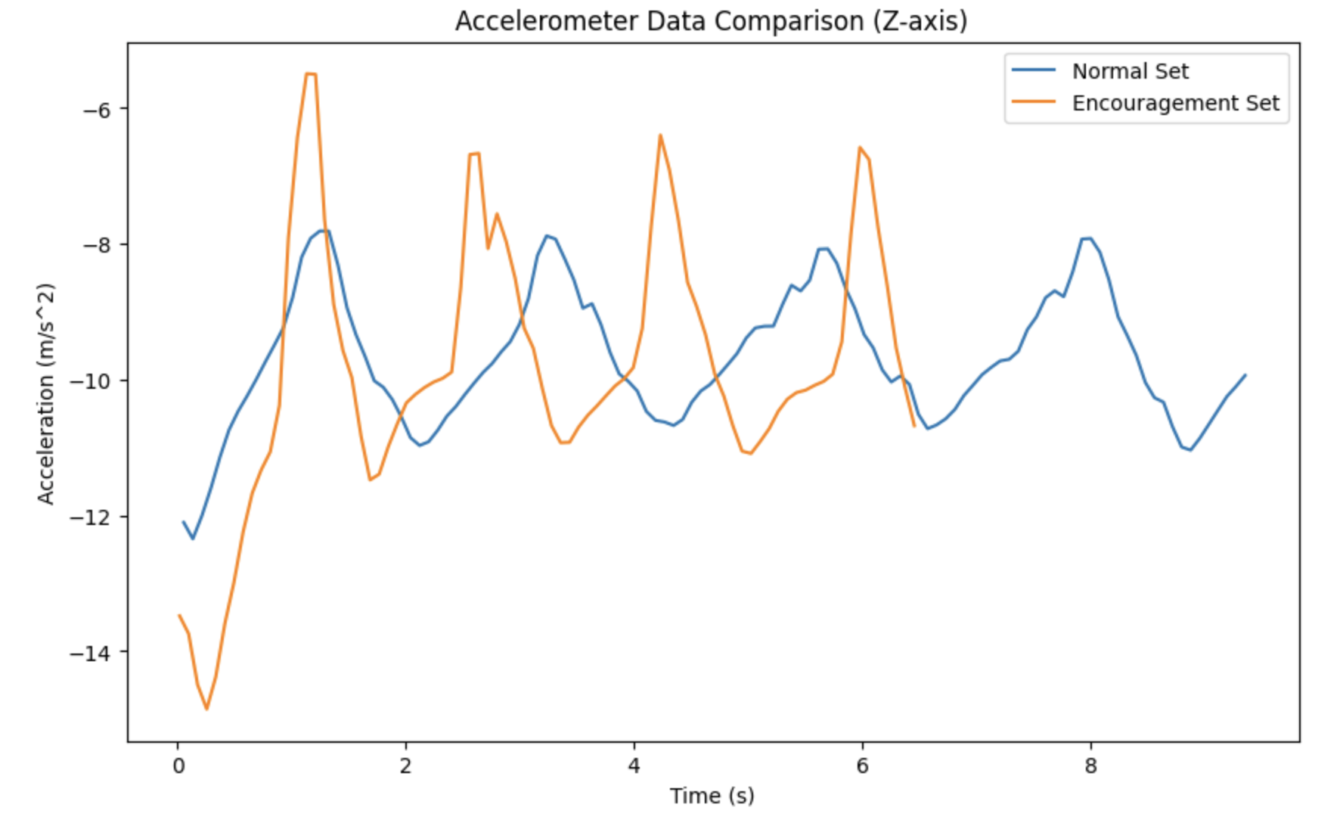
Results (IMU)
- 40% less time for the sets on average.
-More force exerted
- Higher accelerations leading to
more explosive movement.

Slide 9
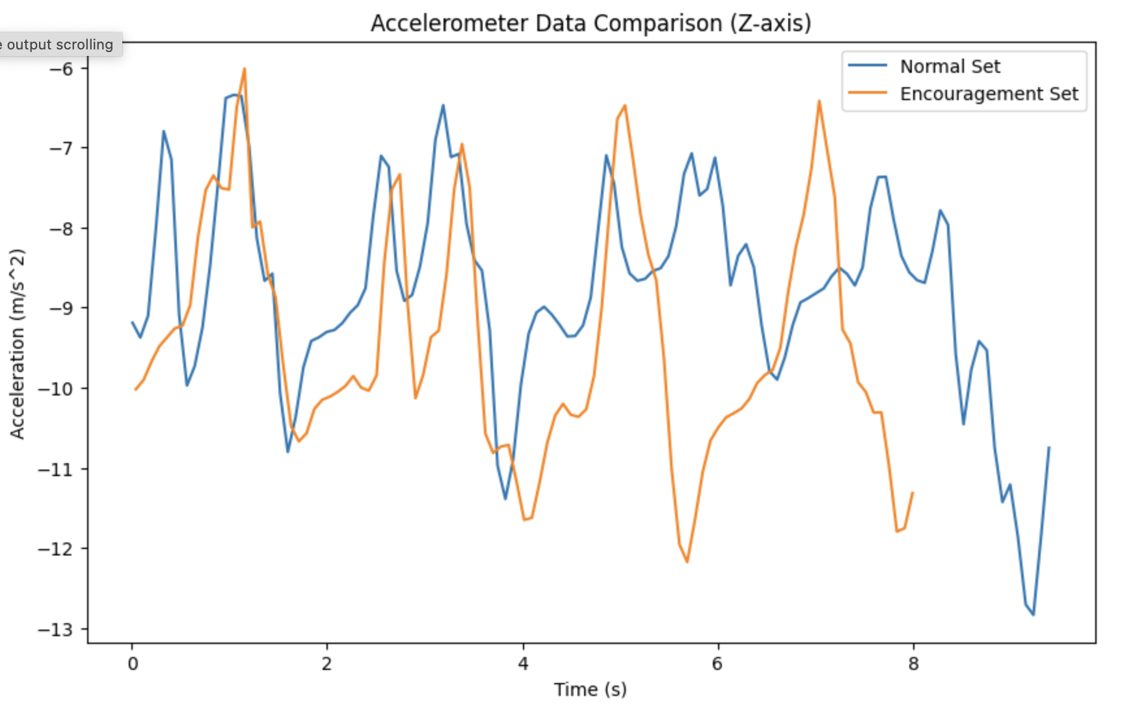
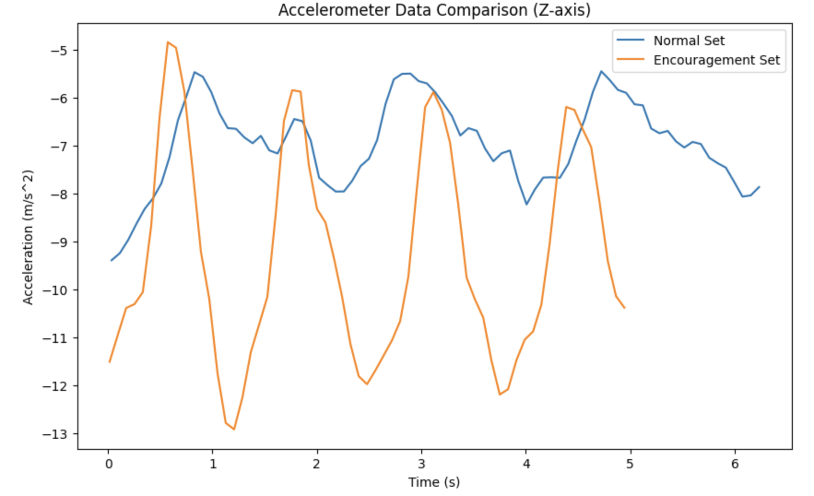
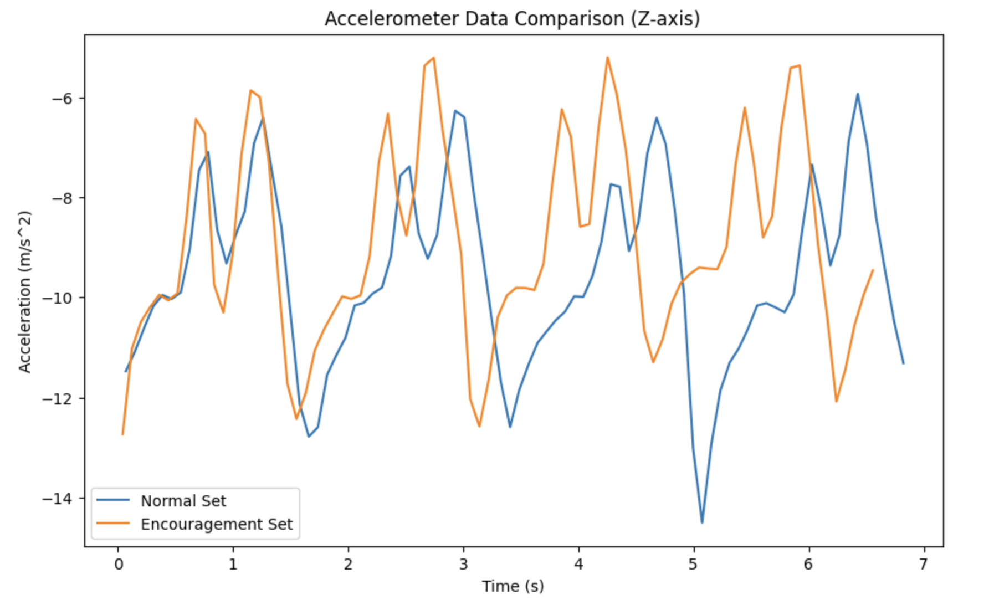
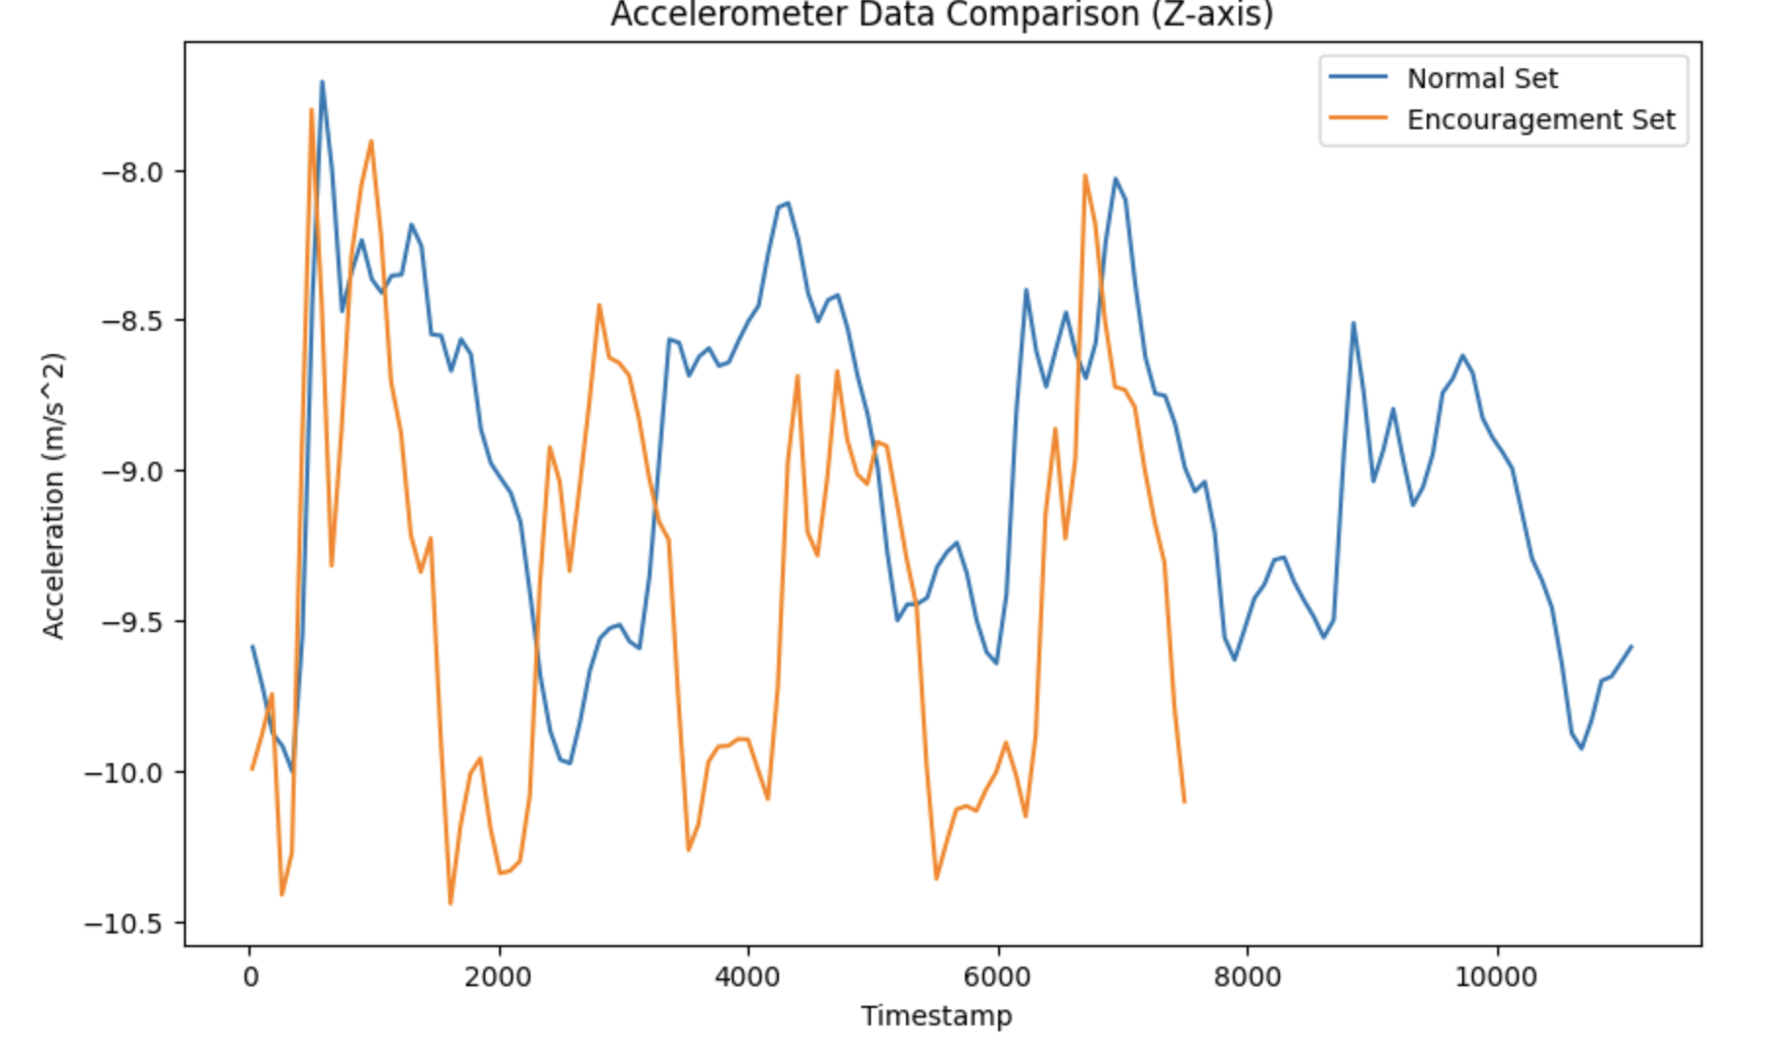
IMU

Slide 10
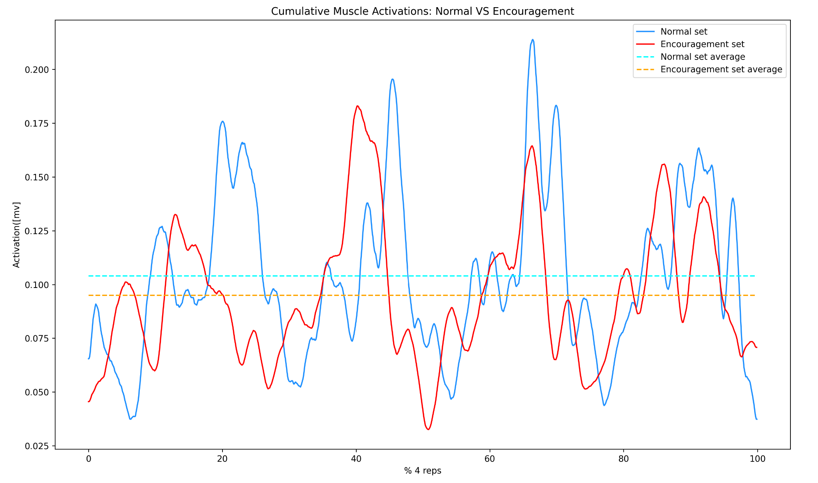
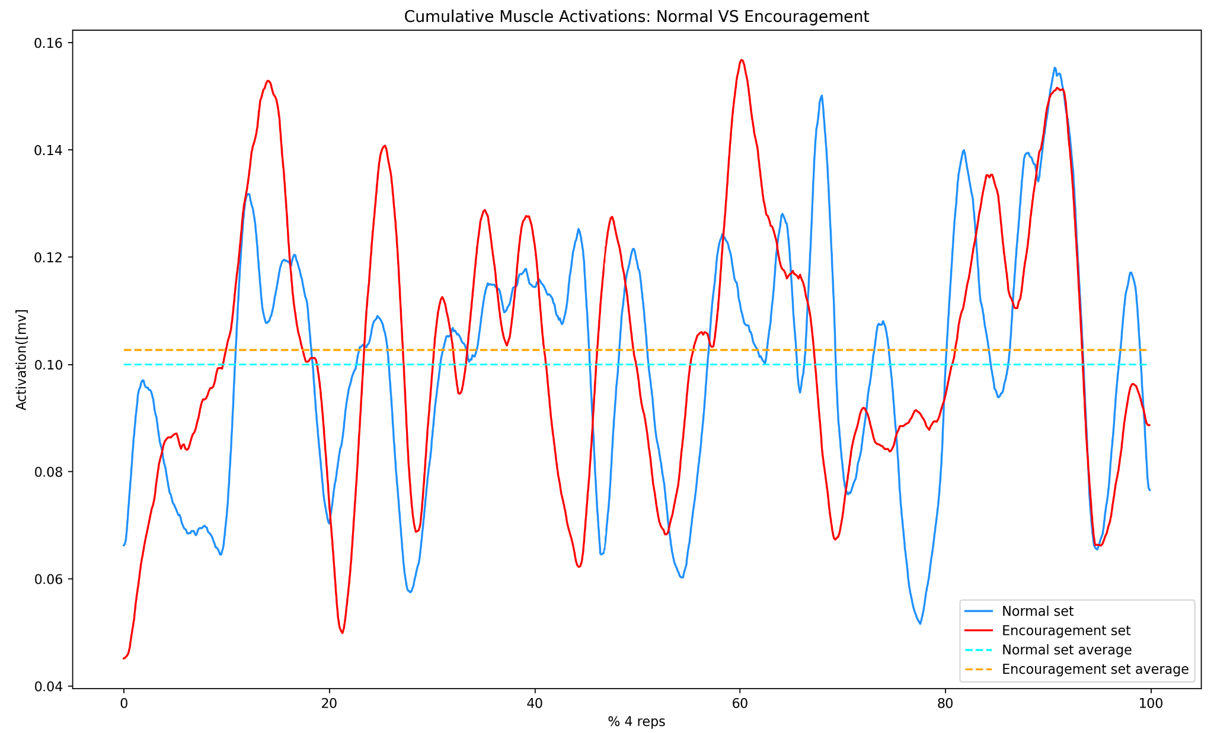
Results (EMG)
3 out of 5 participants had higher sum of muscle activations in the Encouragement Set

Slide 11
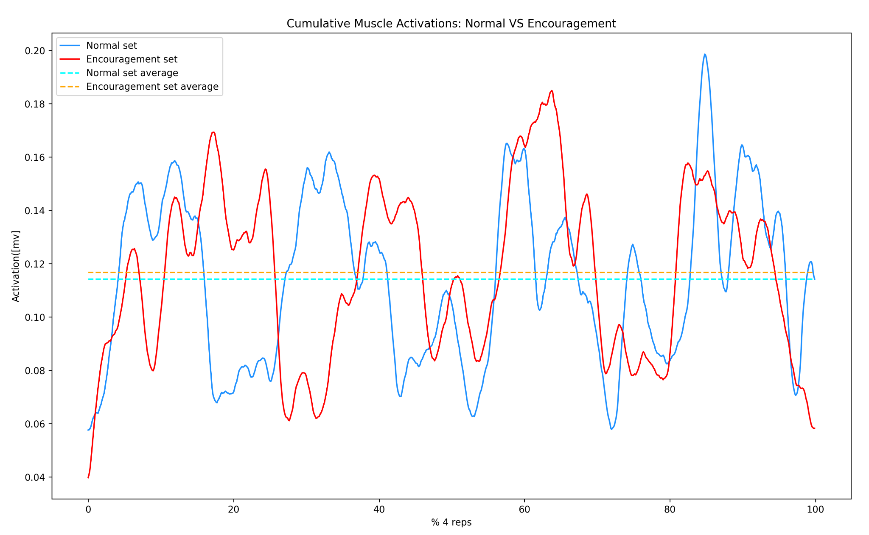
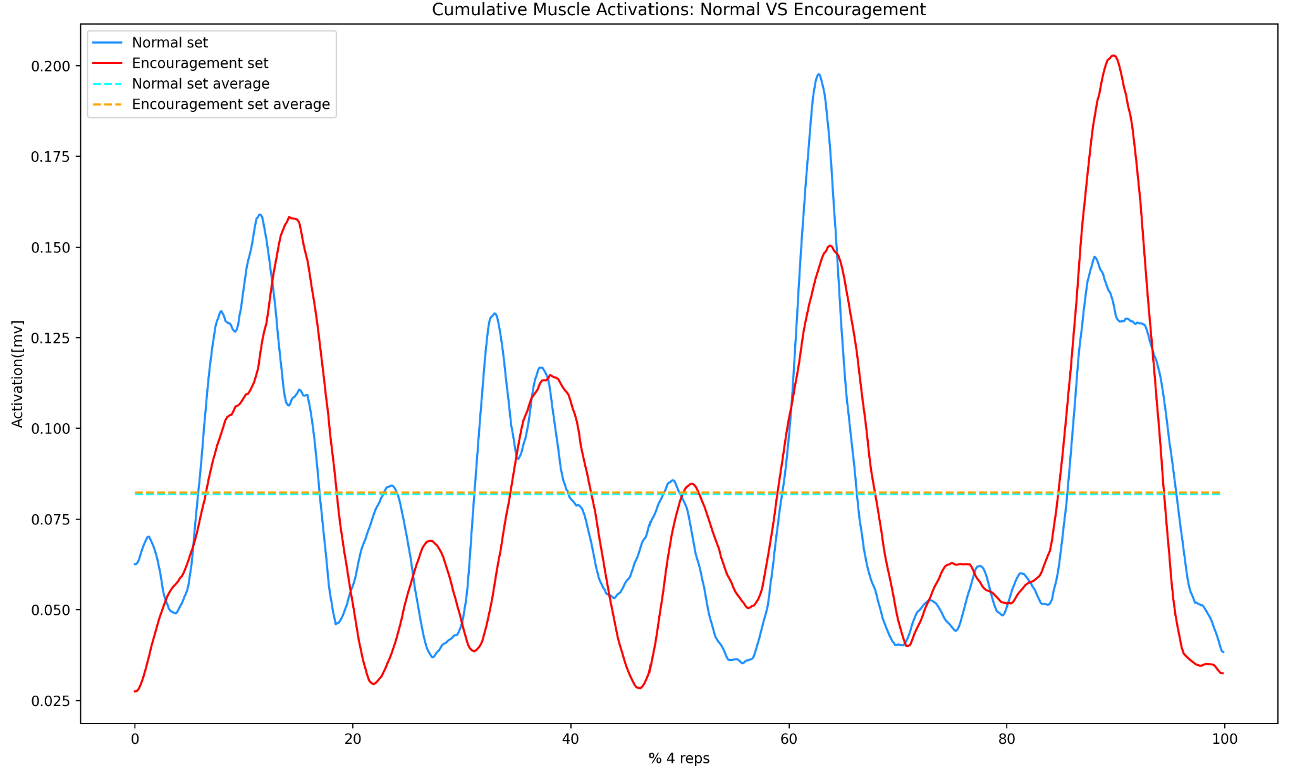
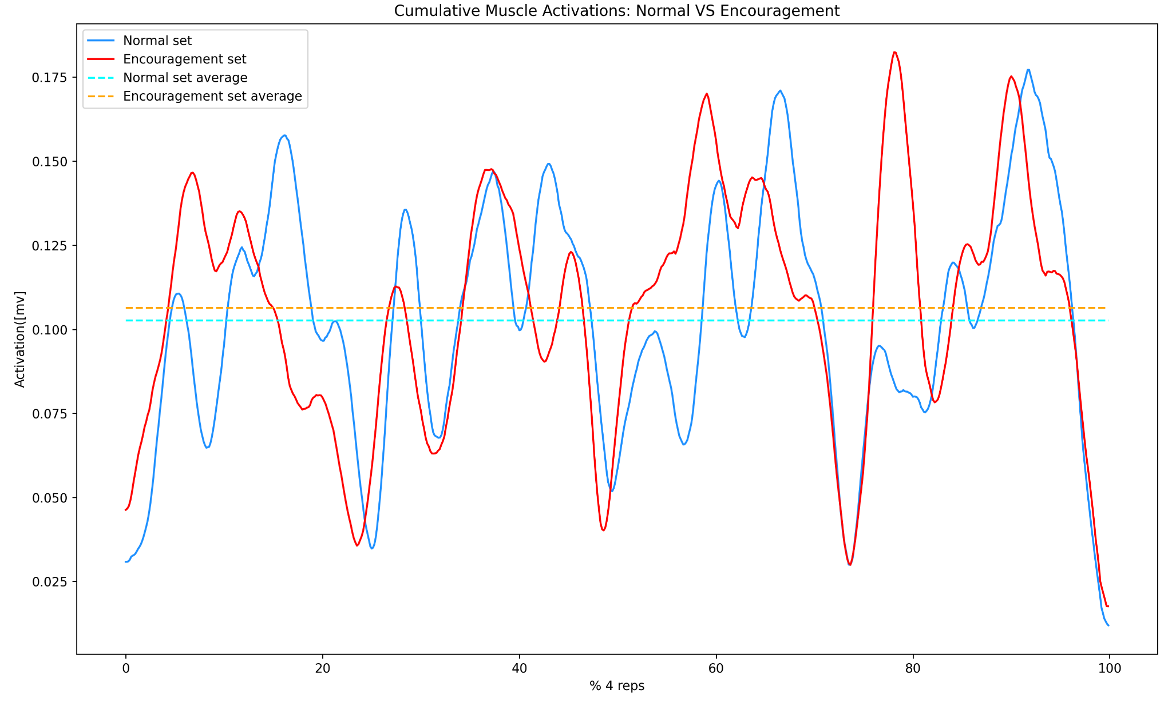
EMG

Slide 12
Conclusions
1) Higher average barbell speed velocity during encouragement sets
2) More explosive repetitions due to faster acceleration during encouragement sets.
3) Higher muscular activations during encouragement set

Slide 13
Future Research
-Larger Sample Sizes
- Placebo Effect
-Random Control Groups
-Testosterone
-Increased Neuromuscular Activity with Spotter

Slide 14
Thank You

